Slide 1
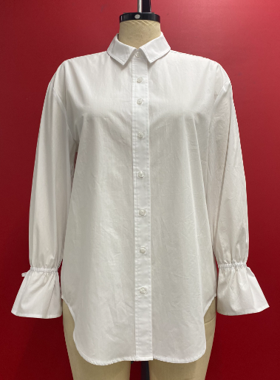
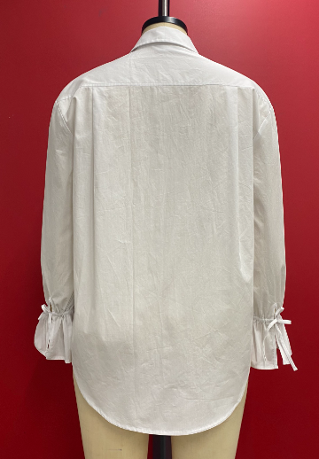
COUNTER SAMPLE
STYLE: WV44W119RS1 FABRIC: #A080006
VENDOR: NOBLAND
SIZE: M
COLOR: MODERN WHITE
BK
FT
BK
BK
FT
BK
BK
FRONT
BACK

Slide 2
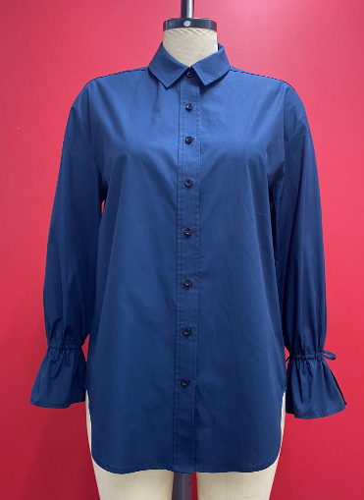
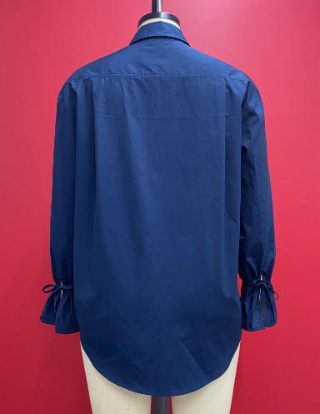
COUNTER SAMPLE
STYLE: WV44W119RS1 FABRIC: #A080006
VENDOR: NOBLAND
SIZE: M
COLOR: NAVY WATER
BK
FT
BK
BK
FT
BK
BK
FRONT
BACK

Slide 3
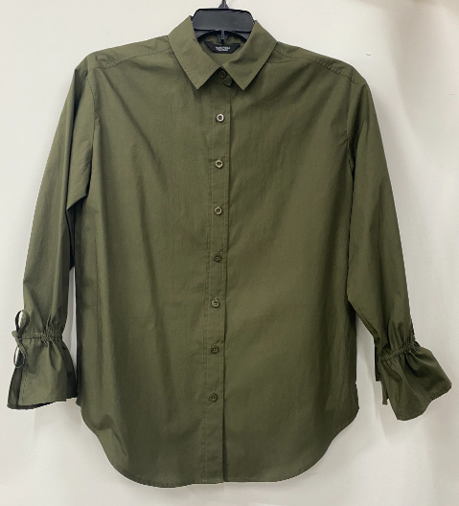
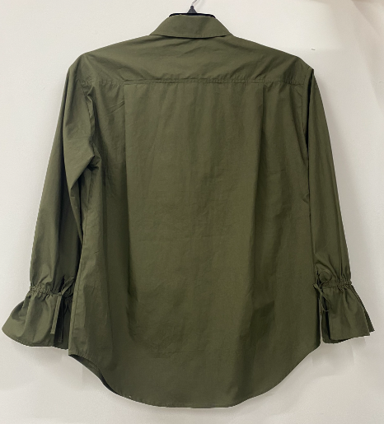
COUNTER SAMPLE
STYLE: WV44W119RS1 FABRIC: #A080006
VENDOR: NOBLAND
SIZE: M
COLOR: 549-710 ARMY BOTTLE
BK
FT
BK
BK
FT
BK
BK
FRONT
BACK

Slide 4
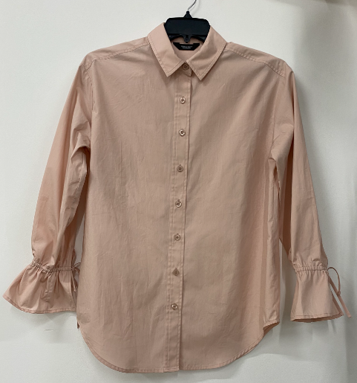
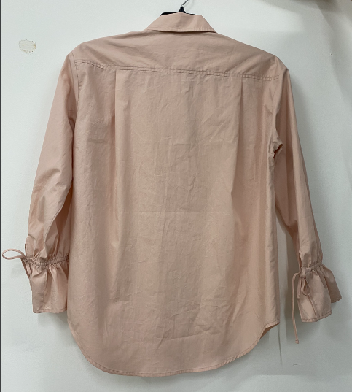
COUNTER SAMPLE
STYLE: WV44W119RS1 FABRIC: #A080006
VENDOR: NOBLAND
SIZE: M
COLOR: ROSE SMOKE 14-1506 TCX
BK
FT
BK
BK
FT
BK
BK
FRONT
BACK

